Slide 1
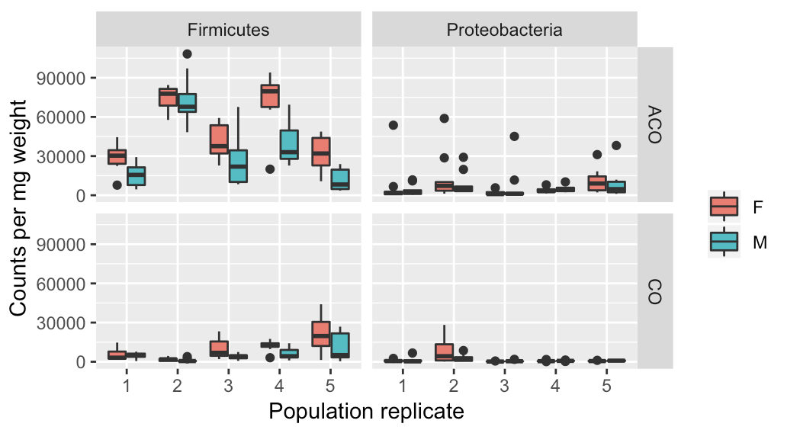
Part I: counts per mg fly
Variable Name | Estimate | Lower CI | Upper CI | p-value
Intercept | 50,266 | 28,300.28 | 72,227.88 | 0.002485
Population CO | - 40,000 | - 65,567.44 | - 14,429.96 | 0.012329
Male | - 17,027 | - 21,656.71 | -12,397.70 | 1.09e-11
Population CO * Male | 12,144 | 55,800.41 | 18,708.88 | 0.000347
Conclusion: all are statistically significant Population ACO > CO Sex male < female
Firmicutes
Variable Name | Estimate | Lower CI | Upper CI | p-value
Intercept | 7,317.3 | 4,600.44 | 10,020.18 | 5.82e-05
Population CO | - 5,241.7 | -7,420.01 | - 3,064.16 | 4.16e-06
Male | - 868.6 | - 3,046.51 | 1,308.58 | 0.433
Conclusion: only population is statistically significant Population ACO > CO Male and female are equivalent
Proteobacteria

Slide 2
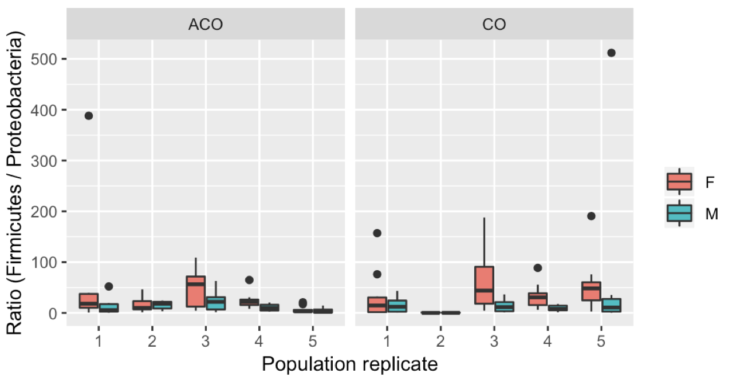
Part II: ratios of count per mg fly (Firmicutes / Proteobacteria)
Variable Name | Estimate | Lower CI | Upper CI | p-value
Intercept | 30.705 | 16.306 | 45.300 | 6.31e-06
Population CO | 7.127 | -7.679 | 21.920 | 0.3507
Male | -17.380 | - 32.242 | - 2.643 | 0.0236
Conclusion: only sex is statistically significant Population ACO and CO are equivalent Sex male < female

